Slide 1
Instacart Basket Analysis
Haley Bustle
November 2023

Slide 2
Project Tools and Resources
Project Duration: Four weeks
Project Resources
The datasets were provided by Career Foundry and were altered for educational purposes only. There were no citations provided on when, where, or how the data was collected
Tools Utilized
Microsoft Office: Word for project brief, data summary, and final project report; Excel used for data changes, statistical analysis, final report
Python and Jupyter for data analysis, wrangling, merging, and creation of visualizations

Slide 3
Project References and Data Sources
Project Resources, please note these are very large dataset that take up a large amount of space:
Data Dictionary
Customer Dataset
Orders & Products Dataset
Orders & Products Prior Dataset
Departments Dataset
Final Report on GitHub
Final Excel Report
This report contains how the datasets were cleaned, analyzed, and merged to the final dataset. It also contains visualizations created with Python and final recommendations.

Slide 4
What is the Instacart Basket Analysis Project?
Project to study a real company using fictionalized data provided by Career Foundry
Aim of project is to better understand customer spending habits and peak shopping hour
Identify busiest day and hour of day for orders
Analyze customer behavior to develop rewards program
Objective of project is to leverage findings to enhance customer experience, optimizing the timing for advertising, sales offers, and coupons

Slide 5
Project Challenges
Data limitations was the largest challenge of this project
Data was manipulated by Career Foundry without a detailed change log
Absence of data timestamps, challenging the relevancy of project usage to real world application
Dataset size was a machine challenge of this project
Final report required integration of five distinct datasets; each dataset required its own processing and analysis
Extensive size of dataset strained machine memory

Slide 6
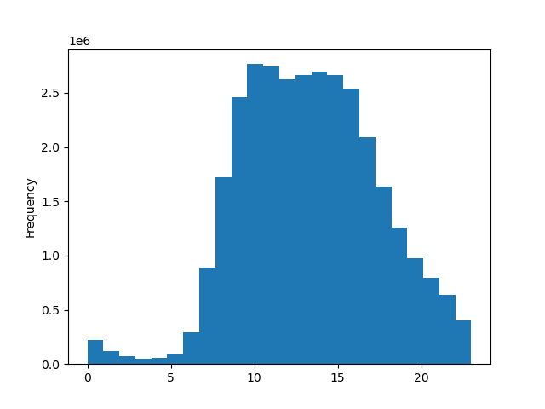
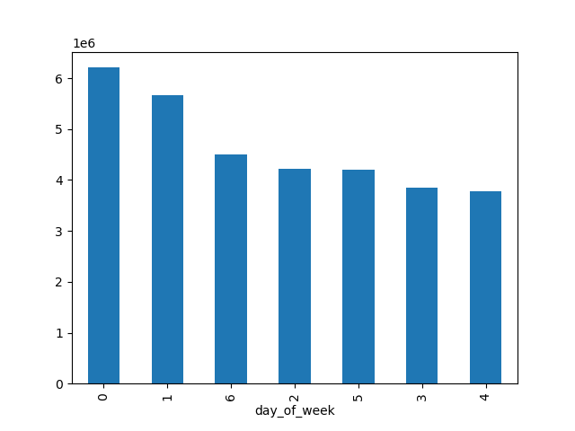
Project Insight: Understanding Customer Activity
The times are identified in US military time (ie, 5 is 0500 or 5:00am, 15 is 1500 or 3:00pm)
Busiest hour of the day starts at 9/0900/9am and persists through 16/1600/4:00pm. Recommend increase advertising at 0600 and continuing through at least 1800 (6:00pm). Include promotions and special offers for
The days are identified on the x-axis as such: 0 (Saturday), 1 (Sunday), 2 (Monday), 3 (Tuesday), 4 (Wednesday), 5 (Thursday), and 6 (Friday)
Busiest day is Saturday (0), then Sunday (1). Recommend advertising through peek hours on Sunday and persisting through Monday (2). Persist customer reward promotions Thursday (5) through Monday (2)

Slide 7
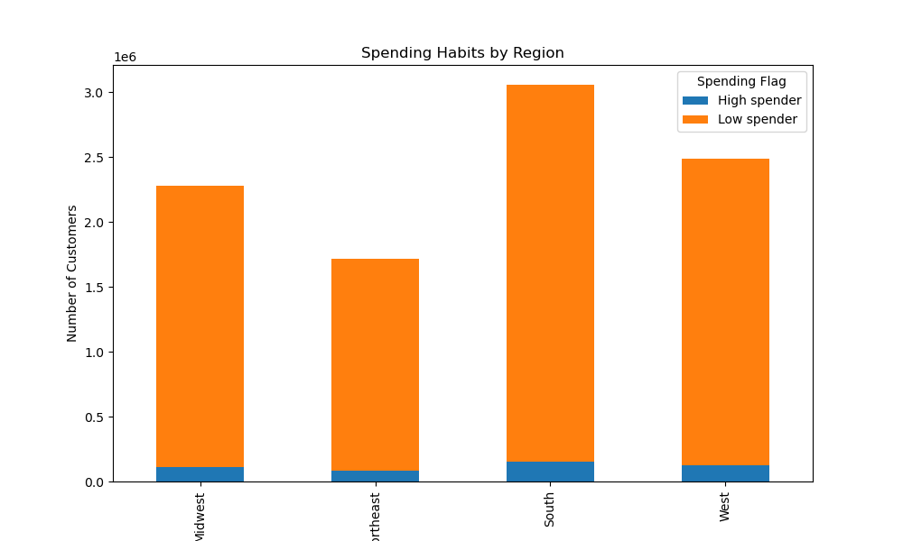
Project Insights: U.S. Regional Customer Analysis
Customers grouped based on their spending, then separated into regions
Low spender: mean price of products purchased is lower than 10 (US $)
High spender: mean price of products purchased is equal or greater to 10 (US $)
Visualization created within Python; axis as follows:
X-axis shows regions of the country in U.S.
Y-axis shows number of customers in millions
Concluded most customers are in South followed closely by the West, and least customers are in Northeast
Continue improving current marketing strategies and store availability to improve and continue positive sales trend in South, West, and Midwest

Slide 8
Project Conclusions and Remarks
Project & Analysis Challenges
Size of final integrated dataset surpassed capabilities of excel and tableau public to create meaningful visualizations
Visualizations created with Python limited in presentation & functionality
Analysis Development
Identifies potential for deeper analysis into customer habits to better personalize marketing and advertisement strategies
Findings from analysis could be used in predictive analysis and better experience for customers
Underscores importance of developing more efficient methods of large dataset collection, integration and analysis

Slide 9
THANK YOU

